Slide 1
This research theme aims at developing data processing and computing technology for helping humans and machines understand each other in the following ways:
Research theme - Data and algorithm assisted AI

Slide 2
This research theme aims at developing data processing and computing technology for helping humans and machines understand each other in the following ways:
By including machine learning methods for interpreting human emotions, intentions, preferences, and decision-making, it analyses facial expressions, body behaviors and physiological signals
Research theme - Data and algorithm assisted AI

Slide 3
This research theme aims at developing data processing and computing technology for helping humans and machines understand each other in the following ways:
By including machine learning methods for interpreting human emotions, intentions, preferences, and decision-making, it analyses facial expressions, body behaviors and physiological signals
Endowing machines with capabilities for expressing emotions through advanced interactive behavior synthesis algorithms
Research theme - Data and algorithm assisted AI

Slide 4
This research theme aims at developing data processing and computing technology for helping humans and machines understand each other in the following ways:
By including machine learning methods for interpreting human emotions, intentions, preferences, and decision-making, it analyses facial expressions, body behaviors and physiological signals
Endowing machines with capabilities for expressing emotions through advanced interactive behavior synthesis algorithms
Helping humans to understand machines by visualising and explaining the internal states and status of data, algorithms, and models through multi-modality for mixed-reality interfaces
Research theme - Data and algorithm assisted AI

Slide 5

This research theme aims at developing data processing and computing technology for helping humans and machines understand each other in the following ways:
By including machine learning methods for interpreting human emotions, intentions, preferences, and decision-making, it analyses facial expressions, body behaviors and physiological signals
Endowing machines with capabilities for expressing emotions through advanced interactive behavior synthesis algorithms
Helping humans to understand machines by visualising and explaining the internal states and status of data, algorithms, and models through multi-modality for mixed-reality interfaces
Research theme - Data and algorithm assisted AI
Prof. Guoying Zhao

Slide 6
This research theme aims at developing data processing and computing technology for helping humans and machines understand each other in the following ways:
By including machine learning methods for interpreting human emotions, intentions, preferences, and decision-making, it analyses facial expressions, body behaviors and physiological signals
Endowing machines with capabilities for expressing emotions through advanced interactive behavior synthesis algorithms
Helping humans to understand machines by visualising and explaining the internal states and status of data, algorithms, and models through multi-modality for mixed-reality interfaces
Research theme - Data and algorithm assisted AI
Prof. Guoying Zhao
Research interests
Computer Vision
Machine Learning
Affective Computing
Image and video representation
Facial expression and micro-expression recognition
Human motion analysis
Remote physiological signal measure
Multi-modal learning

Slide 7
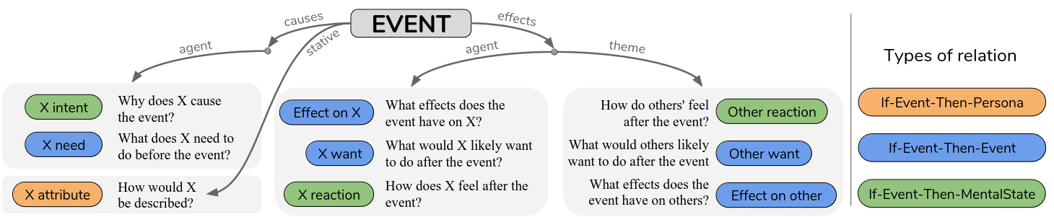
Use ORKA for representing the knowledge gained through the machine learning methods.
Use Atomic for interpreting the knowledge and for deriving additional knowledge.
The goal would be to create a neuro-symbolic system
Ideally, they bring the ML perspective, I bring the KR perspective.
Evaluation through a HRI experiment?
This research theme aims at developing data processing and computing technology for helping humans and machines understand each other in the following ways:
By including machine learning methods for interpreting human emotions, intentions, preferences, and decision-making, it analyses facial expressions, body behaviors and physiological signals
Endowing machines with capabilities for expressing emotions through advanced interactive behavior synthesis algorithms
Helping humans to understand machines by visualising and explaining the internal states and status of data, algorithms, and models through multi-modality for mixed-reality interfaces
Idea #1 - Combine ORKA and ATOMIC?
Research Theme

Slide 8
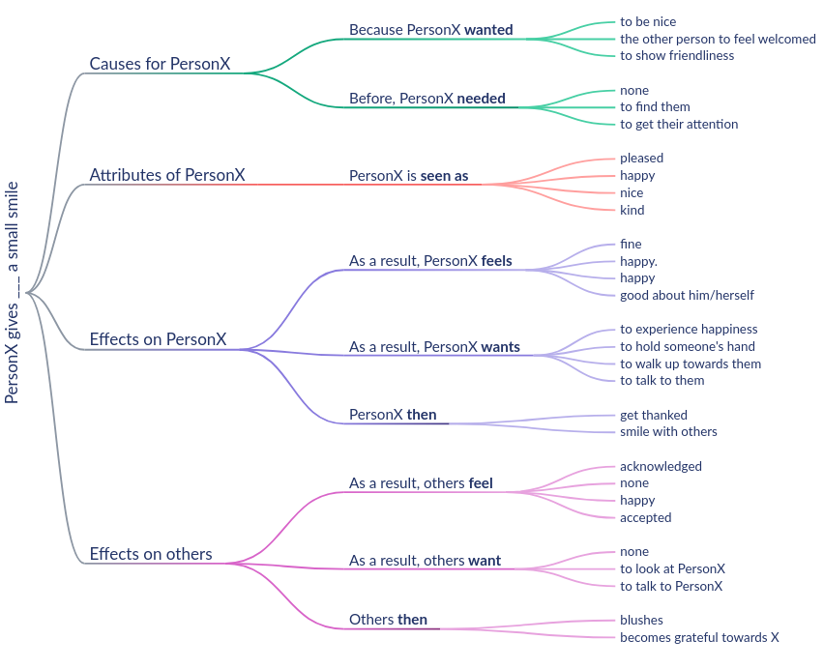
Use ORKA for representing the knowledge gained through the machine learning methods.
Use Atomic for interpreting the knowledge and for deriving additional knowledge.
Link the microexpressions to Atomic
Use the observation graph to filter out the plausible choices?
Use the results (e.g. PersonX then) to verify the next prediction?
Idea #1 - Combine ORKA and ATOMIC?

Slide 9
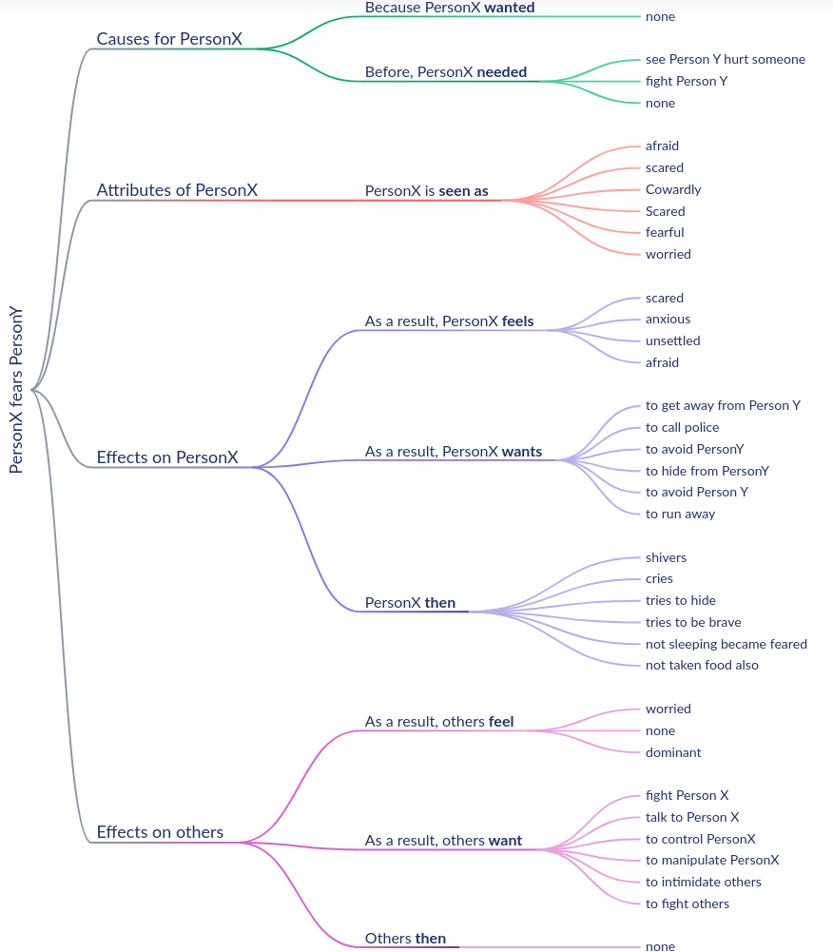
Use ORKA for representing the knowledge gained through the machine learning methods.
Use Atomic for interpreting the knowledge and for deriving additional knowledge.
Link the microexpressions to Atomic
Use the observation graph to filter out the plausible choices.
The goal would be to create a neuro-symbolic system
Ideally, they bring the ML perspective, I bring the KR perspective.
Evaluation through a HRI experiment?
Idea #1 - Combine ORKA and ATOMIC?

Slide 10
Use ORKA for representing the knowledge gained through the machine learning methods.
Use conceptual spaces for visualizing the knowledge gained through the algorithms
The goal would be to create a neuro-symbolic system
Ideally, they bring the ML perspective, I bring the KR perspective.
This research theme aims at developing data processing and computing technology for helping humans and machines understand each other in the following ways:
By including machine learning methods for interpreting human emotions, intentions, preferences, and decision-making, it analyses facial expressions, body behaviors and physiological signals
Endowing machines with capabilities for expressing emotions through advanced interactive behavior synthesis algorithms
Helping humans to understand machines by visualising and explaining the internal states and status of data, algorithms, and models through multi-modality for mixed-reality interfaces
Idea #2 - ORKA and Conceptual Spaces
Research Theme

